Slide 1




High-Quality Code: Course Introduction
Course Program, Evaluation, Exams, Resources
Svetlin Nakov
Technical Trainer
www.nakov.com
Telerik Software Academy
academy.telerik.com

Slide 2

Table of Contents
What's Coming Next in the Academy?
The High-Quality Code Course Program
The Trainers Team
Teamwork Project
Exams and Evaluation
The Practical Exam
Recommended Books
Resources for the Course
Champions from OOP and JavaScript Part I

Slide 3

High-Quality Code
The Next Module in the Software Academy (Programming Track)

Slide 4

What's Coming Next?
High-Quality Code
Continuation of OOP course
Quality coding, unit testing, refactoring, software engineering, design patterns
Pretty much the same
Lectures 2 times a week
The course exam?
Team work project
Practical exam

Slide 5
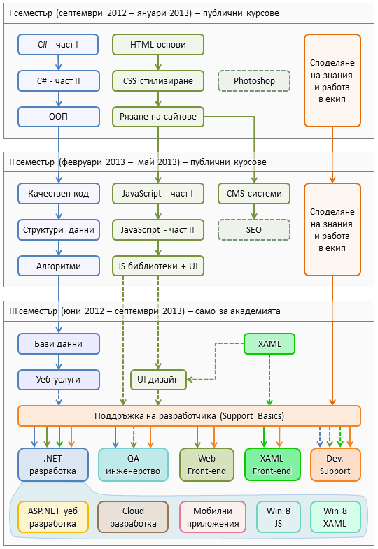

C# Programming Track
Software Academy Curriculum
The C# Programming Track
The Web Front-End Track
Specialties @ the Academy
Success Stories @ Telerik

Slide 6



High-Quality Code Course Program
What Will We Cover in the Course?

Slide 7
The Course Program
Course Overview. Introduction to High-Quality Programming Code. Code Formatting
Correctly Naming Identifiers in the Code (Classes, Properties, Methods, Parameters, Variables, etc.) Code Documentation and Comments
Using Variables, Data, Expressions and Constants. Using Control Structures, Conditional Statements and Loops
High-Quality Methods. Cohesion and Coupling. High-Quality Classes and Class Hierarchies

Slide 8
The Course Program (2)
Defensive Programming and Exceptions. Performance Tuning and Code Optimization
Unit Testing. Mocking. Test-Driven Development
Code Refactoring. Refactoring Patterns. Effective Debugging: Tools and Techniques
Development Tools. IDEs. Change Management Systems. Code Analysis Tools. Automated Testing Tools. Automated Build Tools. Continuous Integration Tools. Team Collaboration Tools
Design Patterns: the Classical GoF Patterns

Slide 9

The Course Program (3)
Fundamentals of Software Engineering (Idea, Architecture, Design, Implementation, Testing, Deployment, Support). Development Methodologies. Scrum. Project Management
Exam Preparation
Teamwork Projects
Teamwork Public Defense
Practical Exam

Slide 10

The Trainers Team

Slide 11
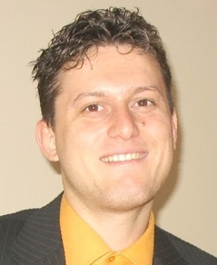
Trainers Team
Svetlin Nakov, PhD
Manager Technical Training @ Telerik Software Academy
20 years software development experience
10+ years experience as trainer
Author of 6 books
Speaker at hundreds of events
E-mail: svetlin.nakov [at] telerik.com
Web site / Blog: http://nakov.com

Slide 12
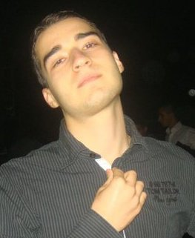
Trainers Team (2)
Nikolay Kostov
Senior Software Developer and Technical Trainer @ Telerik Corp.
Student in Sofia University
Computer Science
IT and Informatics competitions contestant
Graduate from the second season of Telerik Software Academy
Email: nikolay.kostov [at] telerik.com
Blog: http://nikolay.it

Slide 13
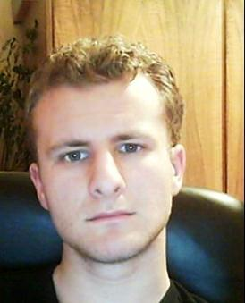
Trainers Team (3)
George Georgiev
Technical Trainer @ Telerik Corp.
Informatics and IT competitions contestant and winner
Student in Sofia University
Software engineering
Graduate from the third season of Telerik Software Academy
E-mail: georgi.georgiev [at] telerik.com
Blog: http://itgeorge.net

Slide 14




Evaluation
Code
Thank God There Are Bonuses!
Quality

Slide 15

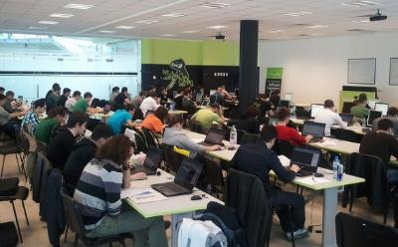
High-Quality Code – Evaluation
Evaluation components
Practical exam – 60%
Team work – 10%
Homework – 10%
Homework evaluation – 10%
Attendance in class – 10%
Bonuses
Forums activity – bonus up to 10%
Helping the other students – bonus up to 10%
PC Magazine / NASA contests – bonus up to 20%

Slide 16


Pass / Excellence / Fail Criteria
Criteria for pass / pass with excellence / fail
Pass with excellence
Very high exam results
or
High total results
Pass
Average total results
Fail
Low total results or 0 at the exam

Slide 17
Homework Peer Reviews
Everyone will get feedback for their homework
Everyone will give feedback for few random homework submissions
Students submit homework anonymously
Please exclude your name from the submissions!
For each homework submitted
Students evaluate 3 random homeworks
From the same topic, after the deadline
Give written feedback, at least 200 characters
Low-quality feedback → report for punishment

Slide 18
Teamwork Project
Teamwork project requirements
Teams of 4 students (balanced random)
Given a low-quality C# project
Refactor the code
Improve its quality and make it testable
Write unit tests (with high coverage) + docs
Use GitHub as source control repository
Each team member should have commits in 5 different days
Public project defense

Slide 19

Practical Exam
You will be given a C# interface
You need to implement it (write the code)
According to the documentation
Write unit tests
High code coverage
Catch all possible defects
Assessment
Unit tests will be automatically checked
Additional manual check

Slide 20



Use the Same Email!
Please use the same email address in:
http://telerikacademy.com
http://bgcoder.com
http://forums.academy.telerik.com
Otherwise your score could be incorrectly calculated!

Slide 21

Recommended Books

Slide 22

The C# Textbook
The official textbook for the course
“Introduction to Programming with C#”, Nakov S. and his team, 2010
Freely downloadable from: www.introprogramming.info
The C# programming tracks follows the book
High-quality code → chapter 21

Slide 23
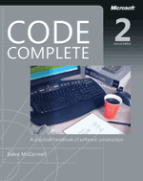


Recommended Books
Code Complete, 2nd Edition, Steve McConnell, ISBN 0735619670, http://www.cc2e.com
Refactoring: Improving the Design of Existing Code, Martin Fowler, Kent Beck, John Brant, William Opdyke, Don Roberts, ISBN 0201485672, http://martinfowler.com/
Test Driven Development: By Example, Kent Beck, ISBN 0321146530

Slide 24








Resources
What We Need in Addition to this Course Content?

Slide 25

Course Web Site & Forums
Register for the "Telerik Academy Forums":
Discuss the course exercises with your colleagues
Find solutions for the exercises
Share source code / discuss ideas
The High-Quality Code official web site:
forums.academy.telerik.com/high-quality-code
http://academy.telerik.com/student-courses/programming/high-quality-code/

Slide 26
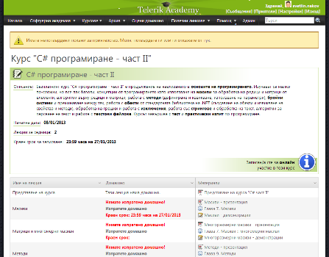
Telerik Integrated Learning System (TILS)
The Telerik Integrated Learning System (TILS)
www.telerikacademy.com
Important resource for all students
Homework submissions
Homework peer reviews
Presence cards with barcode
Reports about your results
telerikacademy.com/Courses/Courses/Details/40

Slide 27


Required Software
Software needed for this course:
Microsoft Windows (XP / Win7 / Win8)
Microsoft Visual Studio 2012 or Visual Studio Express 2012 (free version of VS 2012)
.NET Framework 4.5 (included in Visual Studio)
Visual Studio 2005, 2008 or 2010 is also OK

Slide 28


Champions from the Exams
Telerik Academy Ninja Champions

Slide 29


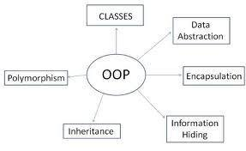
Champions: OOP
#1 – Ivaylo Kenov
#2 – Konstantin Dikov
#3 – Victor Alexiev

Slide 30

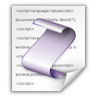
Champions: JavaScript
#1 – Asen Valyovski
#2 – Ivaylo Kenov
#3 – Stanislav Velkov

Slide 31
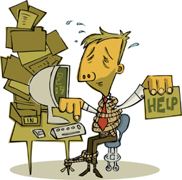


Most Helping Students
OOP: Jasson Jekov
JS1: Kristina Bankova

Slide 32
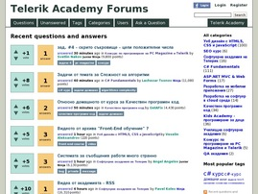
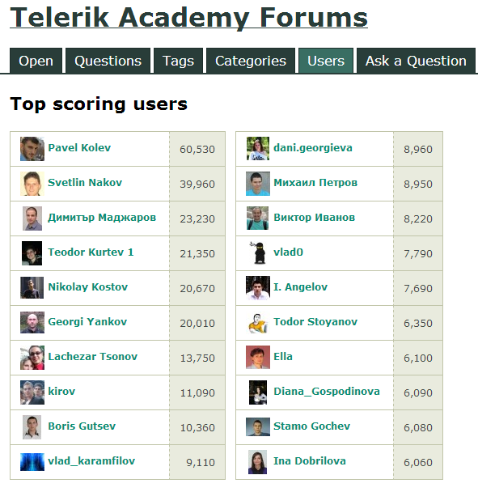
Most Active Students in the Forum
# 1 – Teodor Kurtev

Slide 33

PC Magazine Champions
PC Magazine & Telerik Programming Contest – Round #1
#1 – Pavel Kolev & Atanas Keranov
#2 – Antony Jekov & Dessislava Docheva
#3 – Konstantin Dikov & Nikolay Alexiev
* More info at http://konkurs.pcmagbg.net/results-3-season-2012-2013-2/

Slide 34


The Absolute Champion
The absolute champion of the OOP and JavaScript Part 1 courses:
# 1 – Ivaylo Kenov

Slide 35

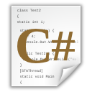
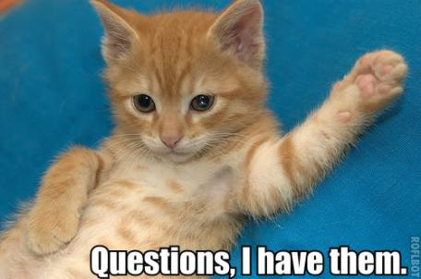
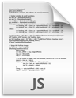

High-Quality Code: Course Introduction
http://academy.telerik.com

Slide 36




Free Trainings @ Telerik Academy
C# Programming @ Telerik Academy
csharpfundamentals.telerik.com
Telerik Software Academy
academy.telerik.com
Telerik Academy @ Facebook
facebook.com/TelerikAcademy
Telerik Software Academy Forums
forums.academy.telerik.com

